Slide 1
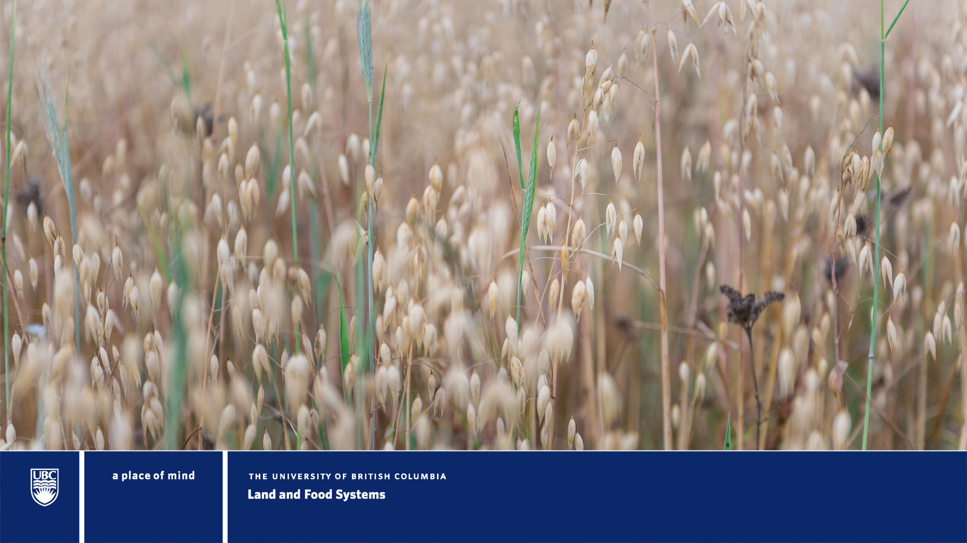
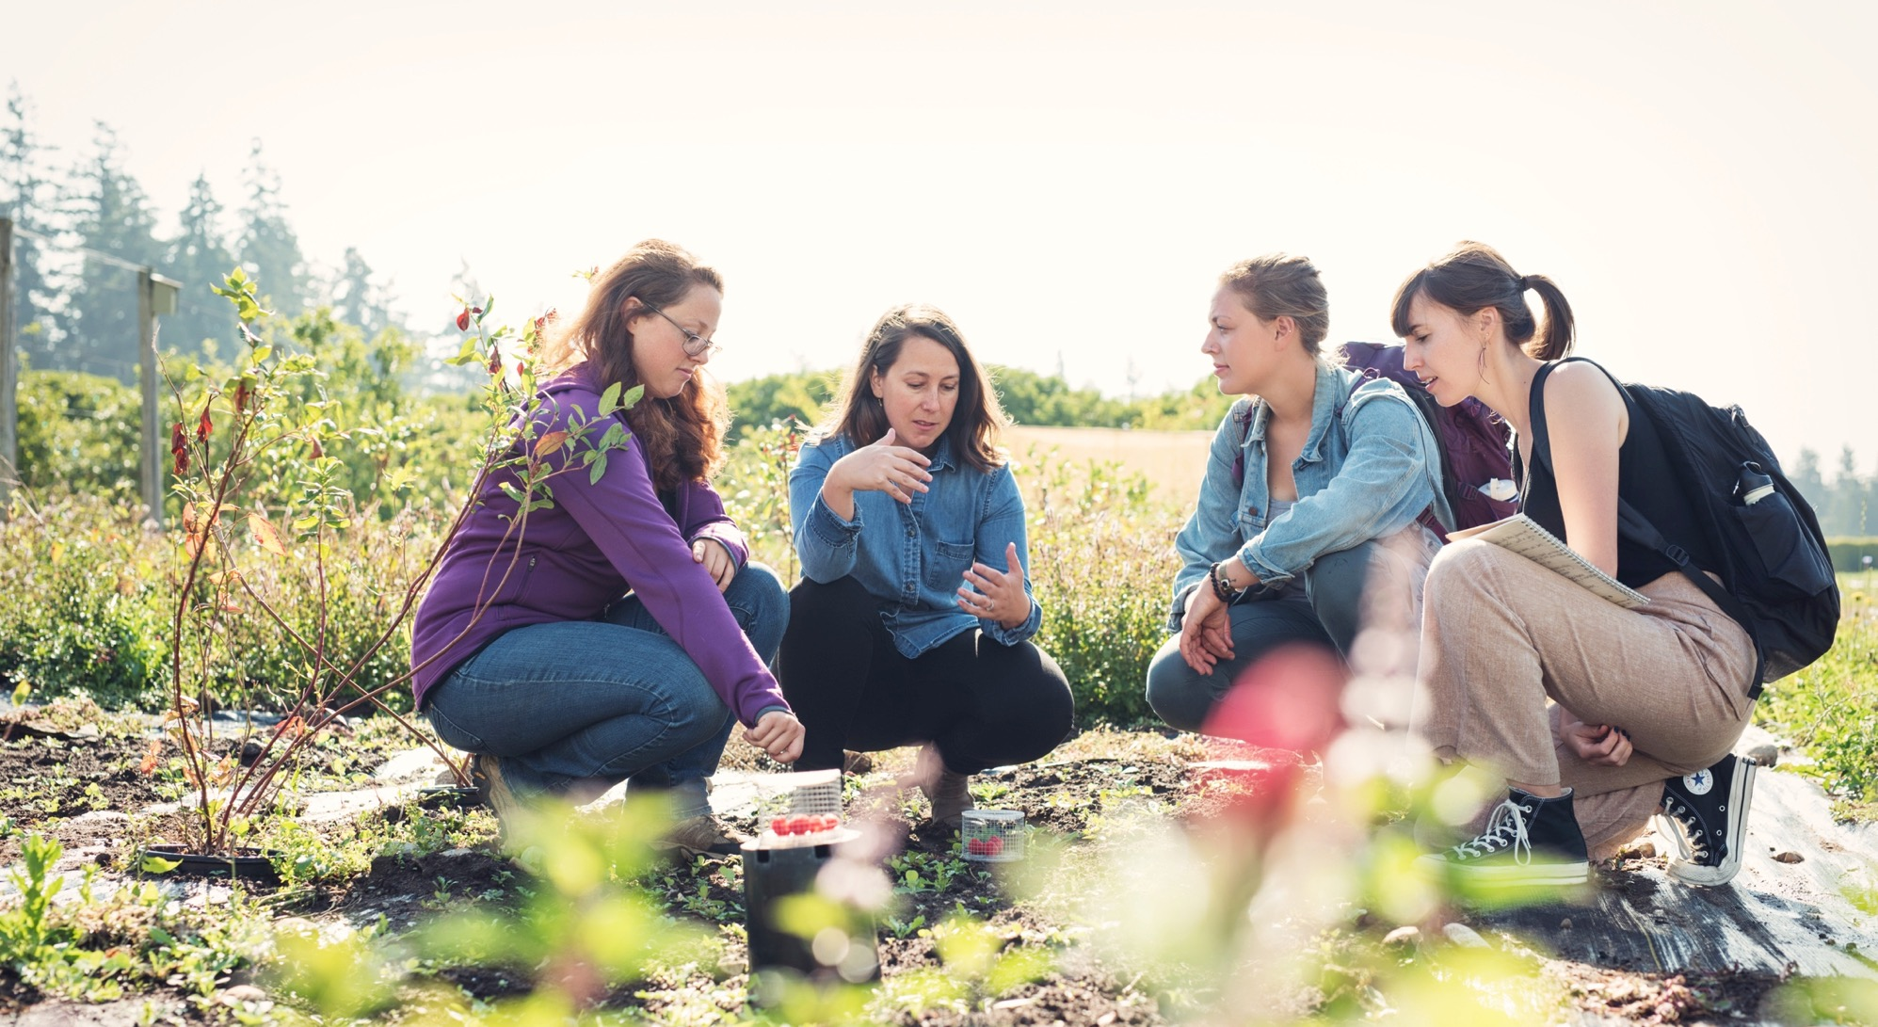

Kevin Cussen
Product Manager
Notes:
Buenos dias a todos y todas. Mi nombre es Kevin Cussen y soy el gerente de producto del proyecto LiteFarm. Gracias por acompañarme hoy.
Lo siento mucho pero no hablo espanol muy bien, así que la presentación será en inglés hoy.
Today I’ll be speaking about LiteFarm – an open source agtech tool for helping sustainable and diversified farmers manage their farms as well as OpenTEAM, an open source consortium LiteFarm is a participant in.

Slide 2
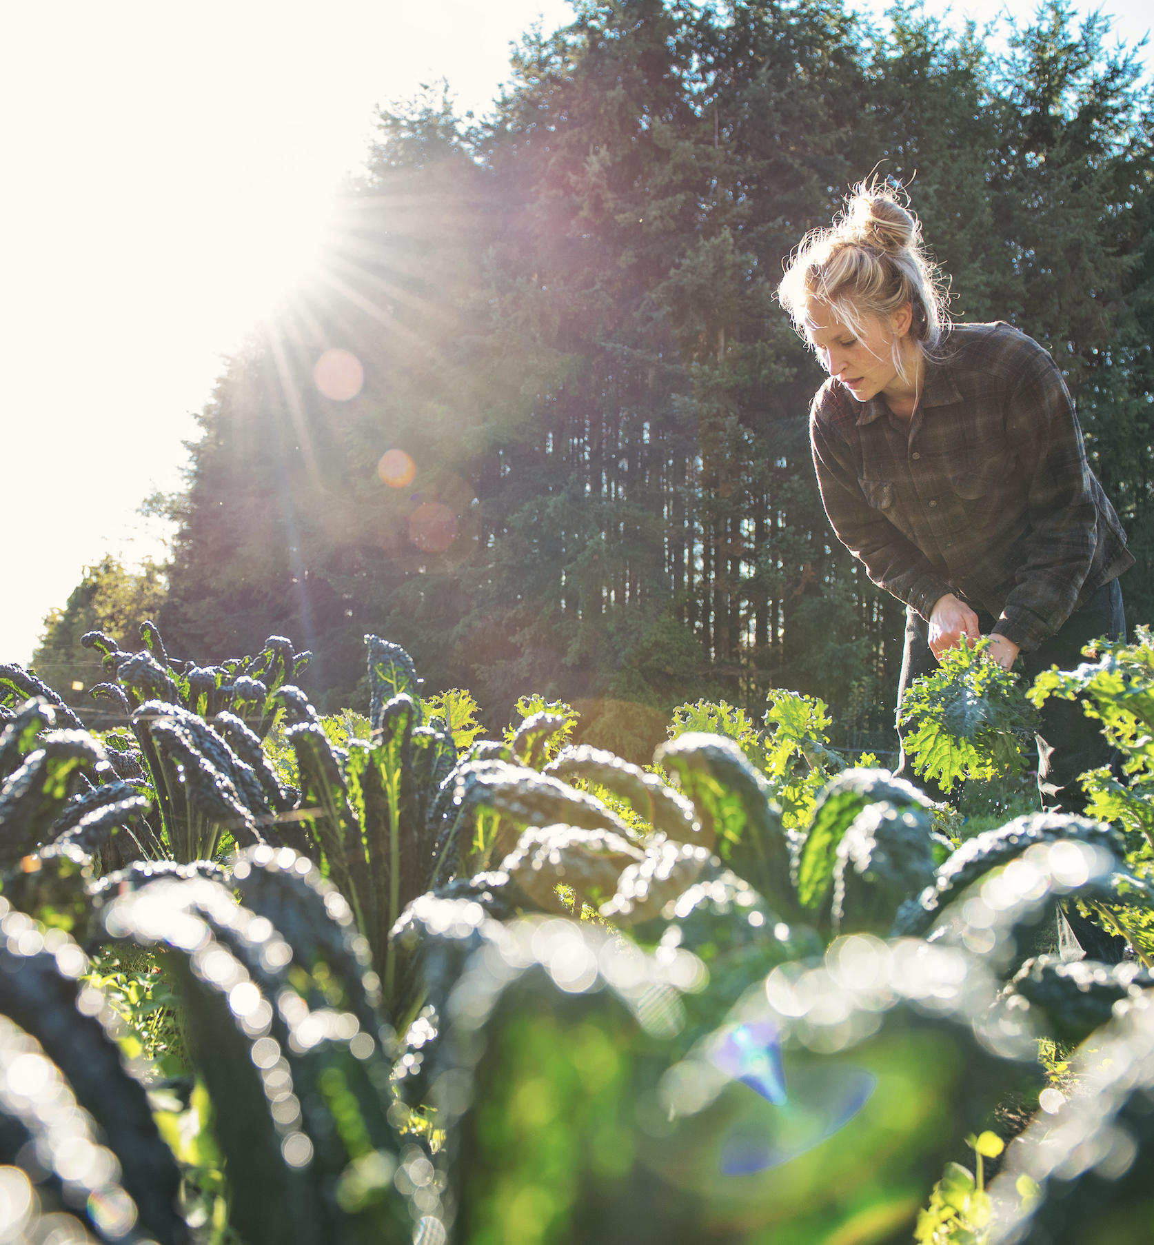
Agenda
A brief history of LiteFarm
Where we are now
Mission statement
Our goal
Our strategy
Roadmap
Winter 2021 release
Roadmap and feature portal
Engaging in the open source community
OpenTEAM
Contributors
Q&A
Notes:
A brief agenda for our discussion today <READ SLIDE>

Slide 3
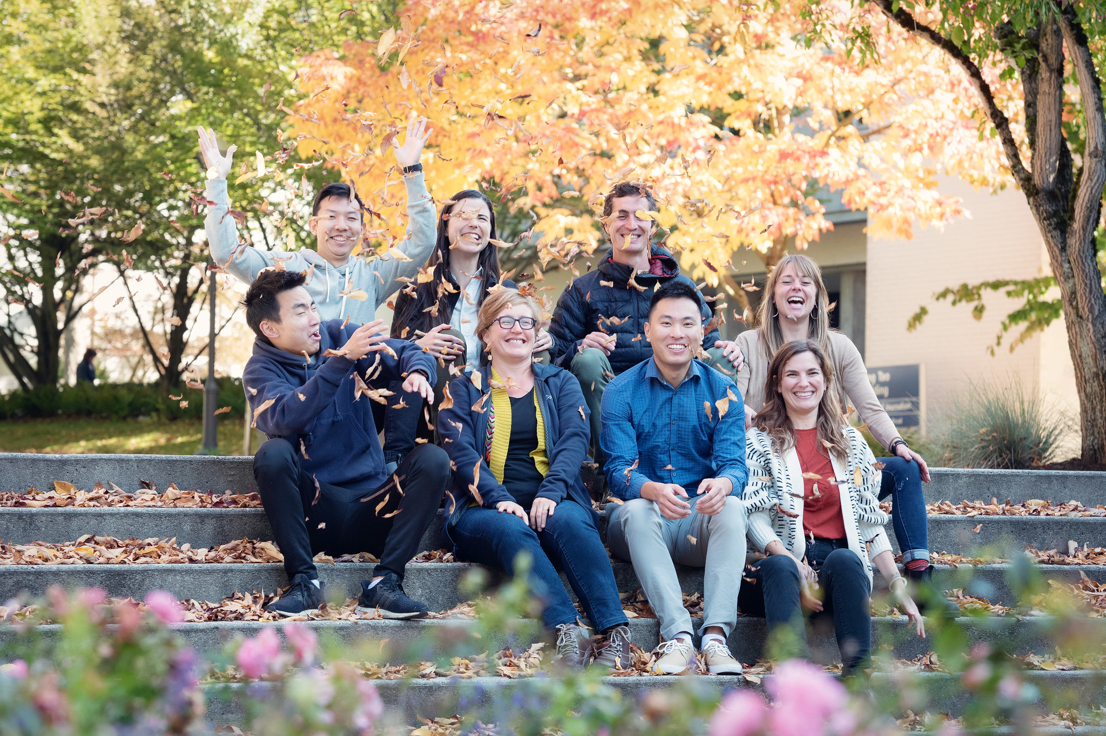
Where we started…
LiteFarm began in 2016 as a simple tool to help farmers calculate the true cost of production per crop at the UBC farm
Developed by Dr.’s Wittman and Mehrabi with a team of part-time students
Extensively co-designed and beta tested by farmers and farmer organizations across Canada

Slide 4
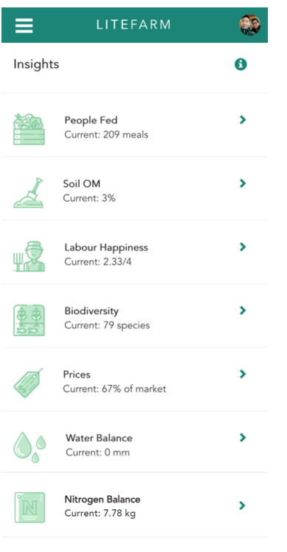
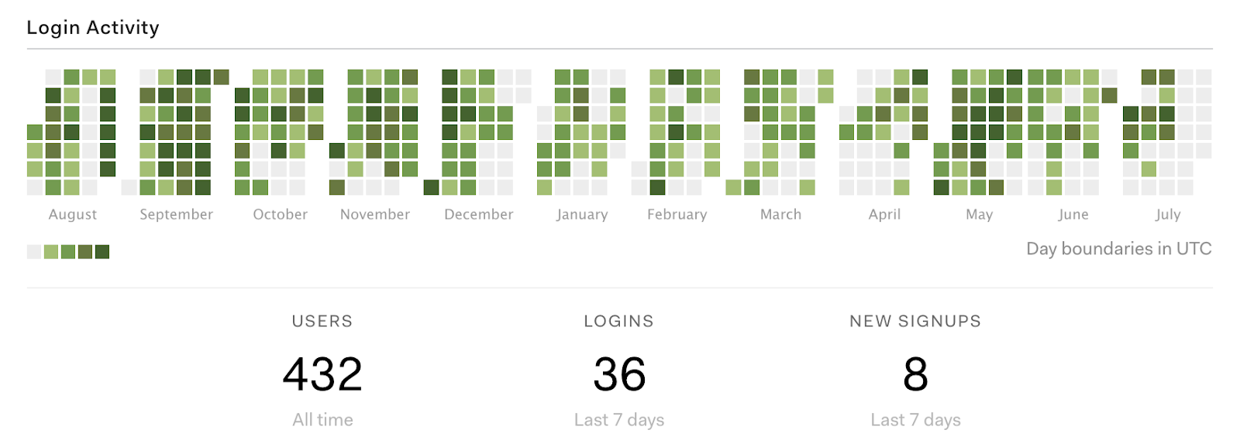
Our product today
A simple farm management app; able to log farm operations, capture cost-per-crop, provide high level financials, and provide basic sustainability insights
V0.9 released on October 15th
A few active users (mostly in Canada)
Notes:
From that modest start, we’ve built a simple farm management app; able to log farm operations, capture cost-per-crop, provide high level financials, and provide basic sustainability insights. On the right, you can see some of the insights we provide to farmers. At the bottom, you can see our modest usage statistics.
However this is only the beginning:
I joined the team in May and two big components of my mandate were to:
1. Develop a strategy for the product
2. Build a team to deliver on that strategy

Slide 5
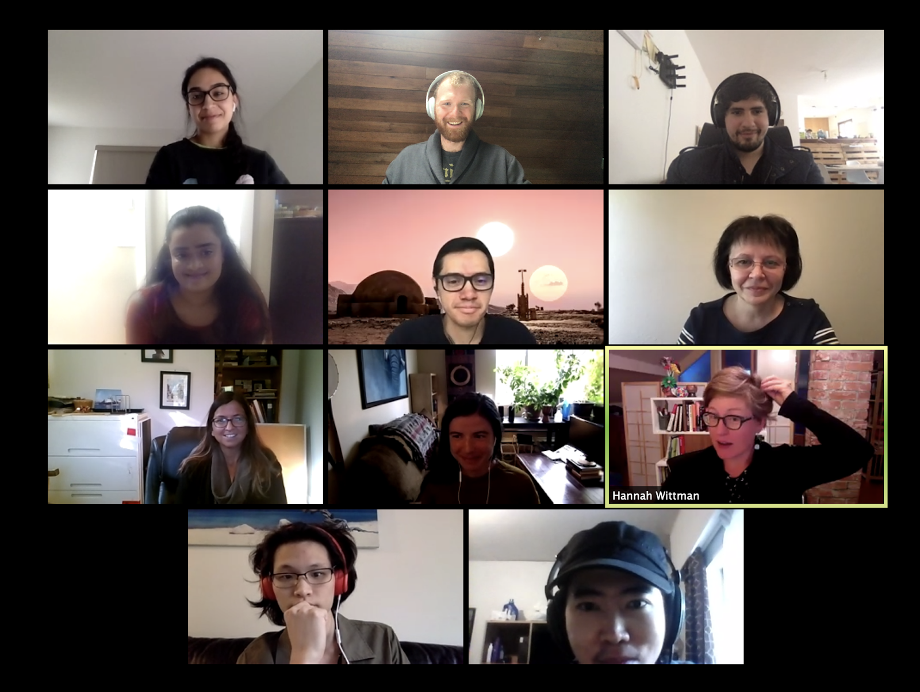
Our team today
(Mostly) transitioned to a full-time scrum team
3 FT student engineers
1 FT senior engineer
1 FT QA engineer (hiring!*)
1 FT UX designer (hiring!*)
1 FT product manager
1 PT SME (farmer liaison)
1 PT research associate
+ contributors just like you!
* Remote / foreign candidates highly encouraged to apply!
Notes:
I’m happy to report that we’ve assembled a fantastic team and we’re still growing! As a matter of fact, we’re hiring two additional positions, a UX designer and QA Engineer. For reasons that will become obvious in a few slides, qualified candidates in central and south America are highly encouraged to apply.
Let me get into the meat of what we’re trying to accomplish at LiteFarm.

Slide 6
Our mission
To meet farmers where they are and equip them with the tools they need to make informed and responsible decisions about the health of their farm, their livelihood, their community, and the planet.
Notes:
Our mission is to: <READ SLIDE>

Slide 7
Our Goal
To put LiteFarm in the hands of 10,000 diversified farmers by 2023
Notes:
And our goal is: <READ SLIDE>
So how do we plan to achieve our mission at this scale?

Slide 8
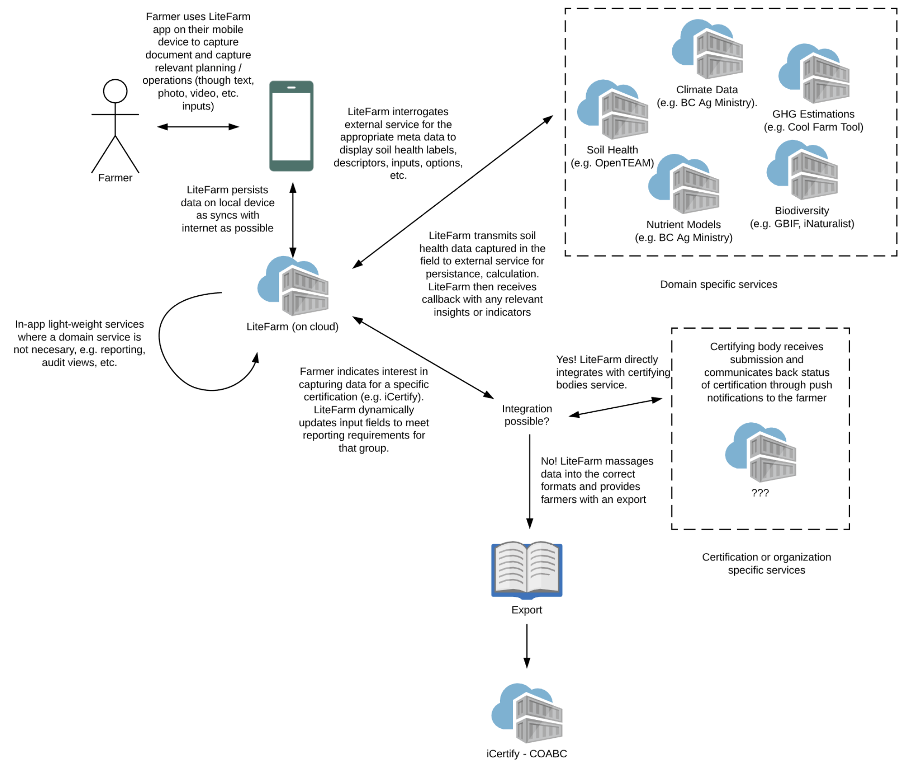
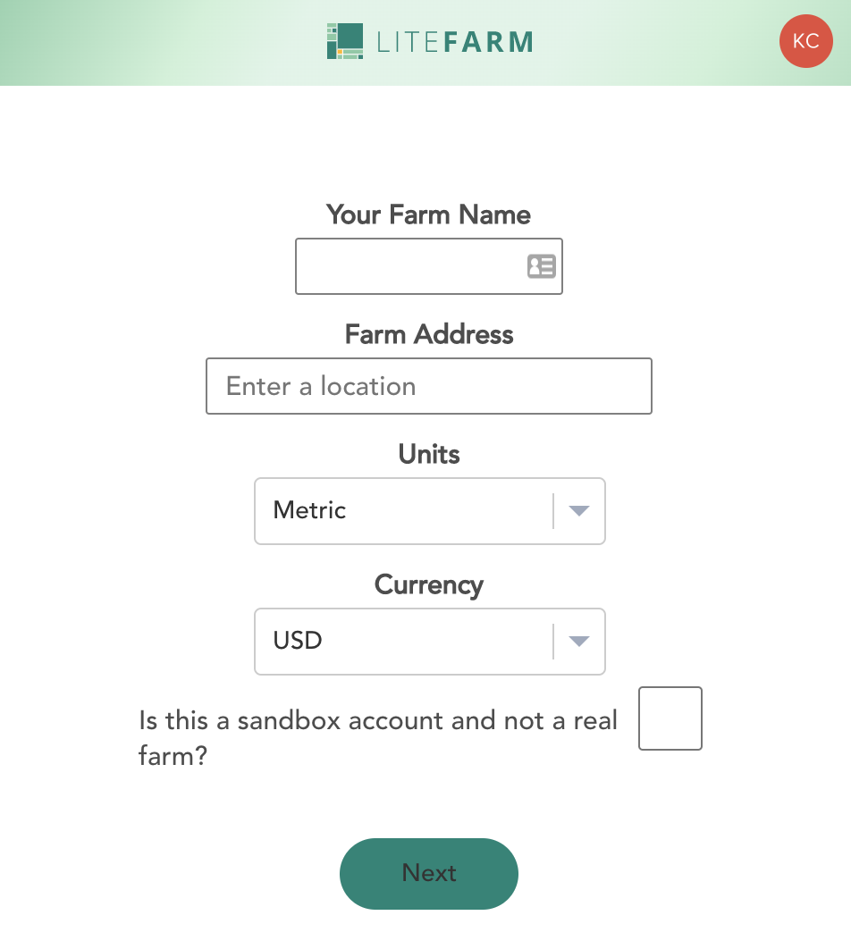
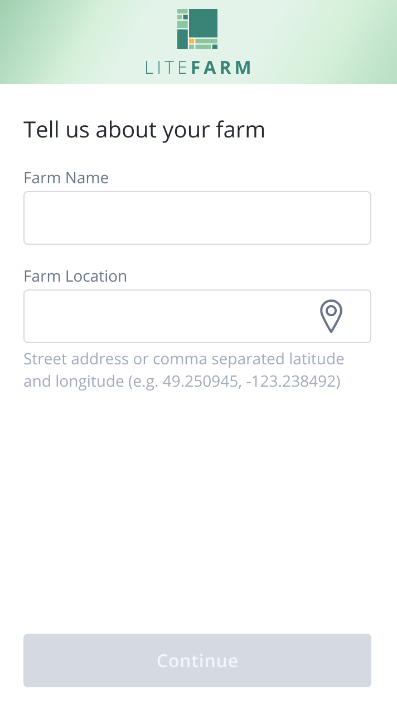
Our strategy
Three pronged:
Focus on usability and utility for diversified farmers
Help farmers make a living
Connect farmers with expert knowledge and tools to improve their practice
Notes:
Our strategy is three pronged.
This means as we’re designing the app our guiding principle is that “Perfection is achieved, not when there is nothing more to add, but when there is nothing left to take away.” We agonize over each field we show on the app. We agonize over anything that is required as an input. What can we infer at any given point? What can we think about so the user doesn't have to. Lets take an example of the onboarding screen in the current version of the app and what it will look like in our Winter release. Units and Currency have been removed because they can largely be inferred from the location. Farm Location now accepts street lookup and raw coordinates – raw coordinates being particularly important for very rural farms. We’ve also added the ability for the user to “find their location”. We’ve also made it contextually clear by disabling the Continue button that those two fields are required.
Our biggest carrot is to help farmers achieve financial success with their farms. Concretely, we’re approaching this through in-app certifications such as organic, and by providing crop-by-crop profitability, and proximity specific anonymized sales data. That means as a farmer, I can see the average of what other farmers are selling produce for in my area.
Lastly, we want to connect farmers with the latest agronomic science. This is where our participation in OpenTEAM and other open source communities comes in. We envision LiteFarm as a “gateway” to new developments in agronomy. We’ll attract the users with our clean experience and pathways to payment and connect them to the powerful domain tools that are developed as part of our open source partnerships.
<slide>

Slide 9
Operationalizing the strategy…
We have partnerships with more than a dozen organizations in Central and Latin America to deploy LiteFarm to cohorts of farmers in 5 Latin American countries starting in January:
Brazil
Ecuador
Mexico
Paraguay
Peru
Notes:
To operationalize this strategy, we’re partnering with farmer organizations around the world. For 2021, we’re really focusing on cohorts in central and south America. <READ SLIDE>
We’ll begin our deployment in January, COVID willing, with the following feature set: <SLIDE>

Slide 10
Features for Winter (January) 2021 release
Theme: International and accessible
New simplified on-boarding flow
Step-by-step farm set-up
Dynamic organic certification form creation
Spanish and Portuguese language support
In-app notifications
Your contributions!
https://portal.productboard.com/litefarm/1-product-portal
Notes:
<READ SLIDE>
If you’re interested in our plans, I encourage you to check out our feature portal at the link shown. You can also access this via our website at litefarm.org
Looking a bit farther in the future:

Slide 11
Longer term candidates (Spring 2021 and beyond)
Task-based farm management
Advanced labour, financial, and inventory tracking
Livestock module
Crop scenario planning
Integration of sensors and actuators for smart irrigation
Holistic sustainability score
Your contributions!
Notes:
<READ SLIDE>
Again, more info is available at our website.
Many of these features, we’re hoping to build with support from contributors such as yourself and in partnership with other open source projects. Specifically, we’re working closely with the OpenTEAM consortium <next>

Slide 12
Engaging with open source communities
We’re interested in:
Helping to build common infrastructure
Ontologies
Role based access control
Common data formats for agricultural data
Integrations to connect farmers to the latest science
Brainstorming, collaboration, and information sharing
Joint funding proposals

Slide 13
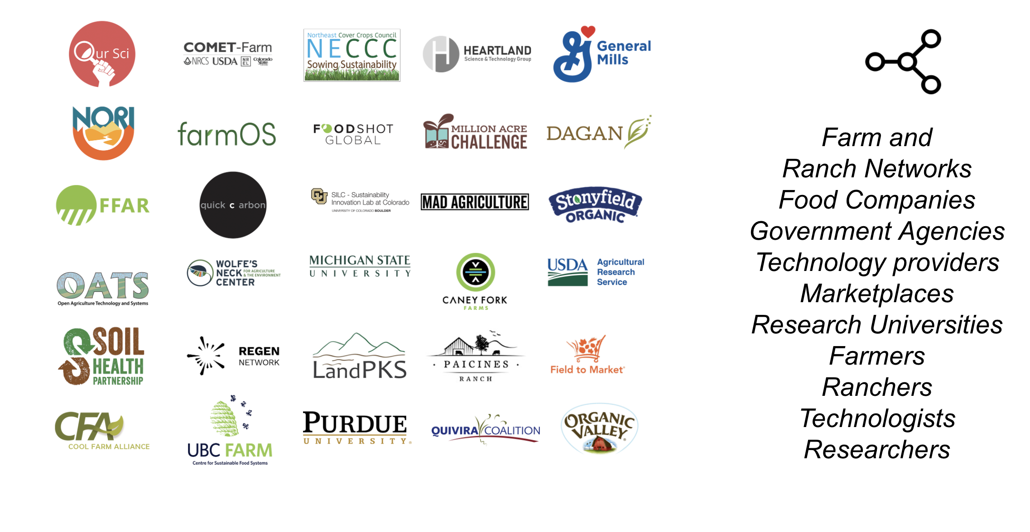
OpenTEAM

Slide 14
OpenTEAM cont.
A shared agtech toolkit for farmers, field technicians, agronomists and others
Rapid and low cost in-field assessment tools
Greater farmer control over their data
Data portability to value-added incentives (certification, conservation payment, ecosystem service credit)
Peer-to-peer learning based on affinities
A way to measure conservation practice effectiveness

Slide 15
Getting involved!
Website: https://litefarm.org
We’re hiring! https://www.litefarm.org/careers
Repo: https://github.com/LiteFarmOrg/LiteFarm
Wiki: https://lite-farm.atlassian.net/wiki/spaces/LITEFARM/
Latest build: https://beta.litefarm.org
Stable build: https://app.litefarm.org
API doc: http://api.litefarm.org
Roadmap & Feature portal: https://portal.productboard.com/litefarm/

Slide 16

kcussen@litefarm.org
ldemmel@openteam.community

